Slide 1
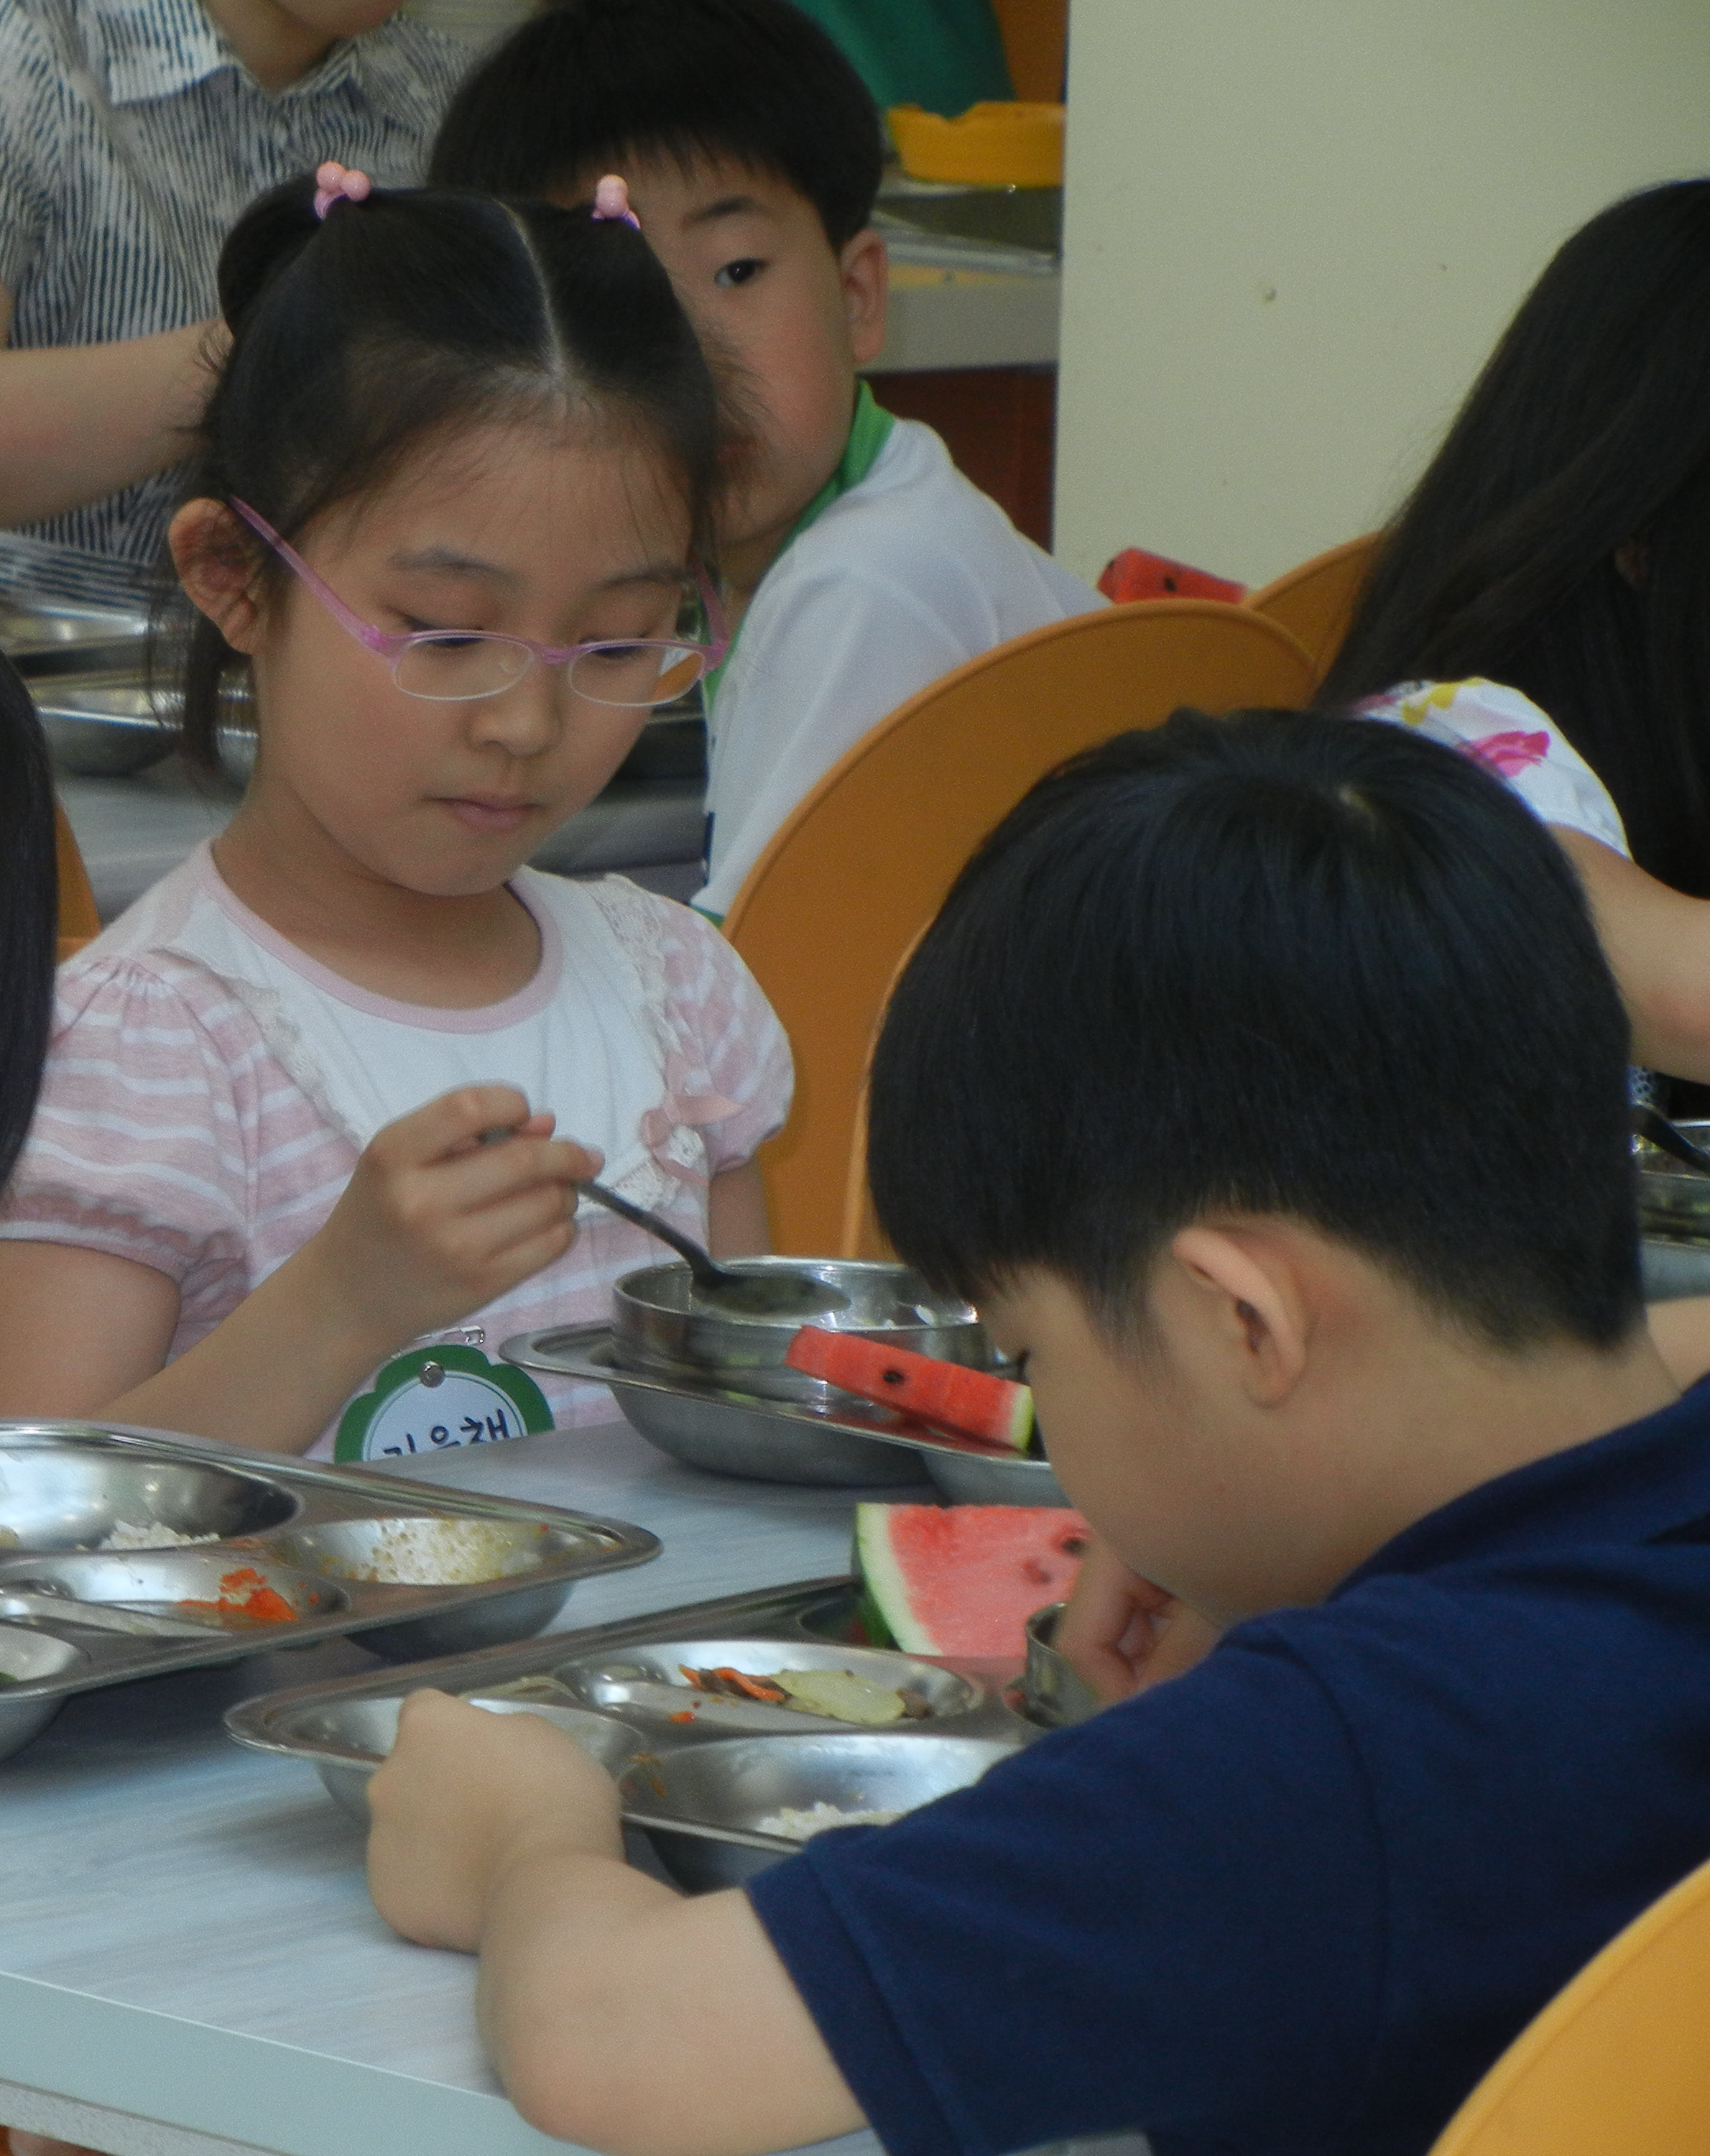
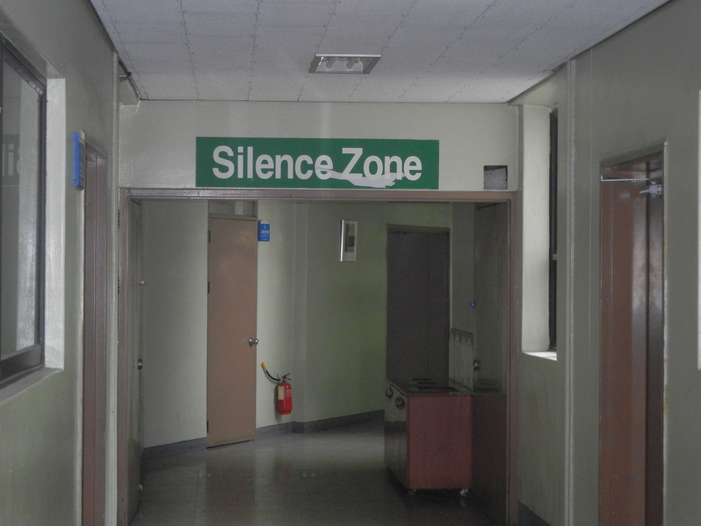
A Day in the life of a Korean Student

Slide 2
Quiz Time!!!

Slide 3
How to Play?

Slide 4
Let’s Play!!!

Slide 6
Historical Development of Korean Education
Pre-Modern Education (Until 19th Century)
Informal Education- Taehak
Ethics education based on Confucianism and Buddhism
Expansion of Democratic Education (1945-1950)
Liberation from Japan
“Movement to save the nation through education”
National and Private institutes established due to Independence Movement
Education Law passed in 1949
6-3-3-4 Pattern
Focus on literacy rate

Slide 7
Historical Development of Korean Education
Quantitative Expansion (1960s and 70s)
Increase in student population
Teacher quality
Qualitative Development (1980s)
Human Education Preparing for Future Society (1990s and Beyond)
Improvement in education facilities
Normalization of the education system
Fifth Republic

Slide 8
Today’s Instructional System

Slide 9
National Curriculum Framework
 |  | Elementary School |  |  |  |  |  | Middle School |  |  | High School
 |  | 1 | 2 | 3 | 4 | 5 | 6 | 7 | 8 | 9 | 10 | 11 | 12
S u b j e c t A r e a s | Korean Language | Korean Language 210 238 Mathematics 120 136 Discipline Life 60 68 Intelligent Life 90 102 Pleasant Life 180 204 We are the first graders 80 · |  | 238 | 204 | 204 | 204 | 170 | 136 | 136 | 136 | Elective Course
 | Moral Education |  |  | 34 | 34 | 34 | 34 | 68 | 68 | 34 | 34
 | Social Studies |  |  | 102 | 102 | 102 | 102 | 102 | 102 | 136 | 170 (Korean History 68)
 | Mathematics |  |  | 136 | 136 | 136 | 136 | 136 | 136 | 102 | 136
 | Science |  |  | 102 | 102 | 102 | 102 | 102 | 136 | 136 | 102
 | Practical Arts |  |  | · | · | 68 | 68 | Technology·Home Economics
 |  |  |  |  |  |  |  | 68 | 102 | 102 | 102
 | Physical Education |  |  | 102 | 102 | 102 | 102 | 102 | 102 | 68 | 68
 | Music |  |  | 68 | 68 | 68 | 68 | 68 | 34 | 34 | 34
 | Fine Arts |  |  | 68 | 68 | 68 | 68 | 34 | 34 | 68 | 34
 | Foreign Languages (English) |  |  | 34 | 34 | 68 | 68 | 102 | 102 | 136 | 136
Optional Activities |  | 60 | 68 | 68 | 68 | 68 | 68 | 136 | 136 | 136 | 204
Extracurricular Activities |  | 30 | 34 | 34 | 68 | 68 | 68 | 68 | 68 | 68 | 68 | 8 units
Grand Total |  | 830 | 850 | 986 | 986 | 1088 | 1088 | 1156 | 1156 | 1156 | 1224 | 144

Slide 10
English Education at Public Schools
Starting Age of Learning English at Schools:
3rd grade (9 years old) of elementary school
School Level | Grade | Teaching Hours (Total) | Class hour
Elementary school | 3 – 4 | 34 (one hour/week X 34 weeks) | 40 minutes
 | 5 – 6 | 69 (two hours/week X 34 weeks)
Middle school | 1 – 2 | 102 (three hours/week X 34 weeks) | 45 minutes
 | 3 | 136 (four hours/week X 34 weeks)
High school | 1 | 136 (four hours/week X 34 weeks) | 50 minutes
 | 2 – 3 | 136 (four hours/week X 34 weeks)
English Teaching Hours (Moe, 2006 January)

Slide 11
Teacher Training
Teacher Program
4-year program
Teacher Certification/Examination
Grade 2
Post-employment Training
Classroom supervision and instruction
Instructional guidance and evaluation
Grade1
3 years of experience
15 credit hours of in-service training
Score on College Scholastic Ability Test
Elementary- Top 5% of high school cohort
Student Guidance
Employment Test
Positions filled based on test score rankings

Slide 12
Teacher Quality

Slide 13
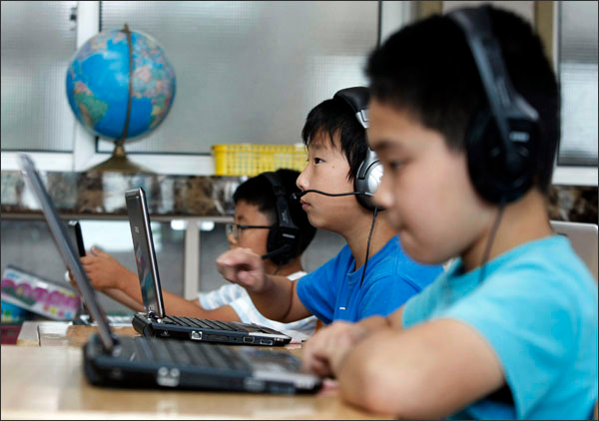
A Typical School Day for a Korean Student

Slide 14
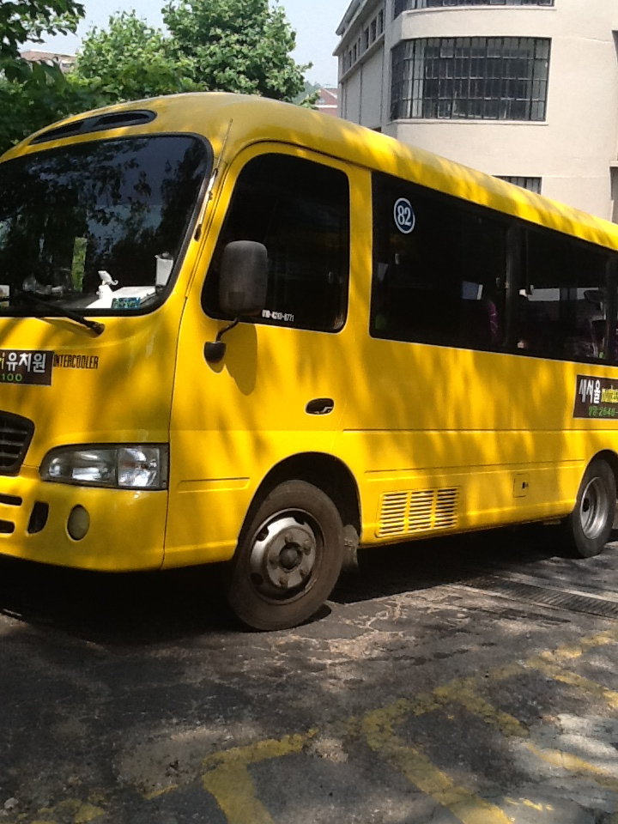
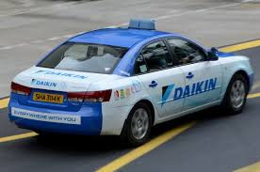
Transportation to School
Taxi
School Bus
Subway

Slide 15
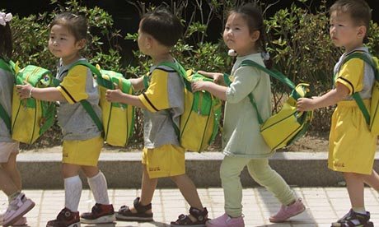
kindergarten

Slide 16
Kindergarten (age 4 - 6):
Public Schools
Non-Compulsory
Private Kindergarten
Korean subjects
Introduction to the English language

Slide 17
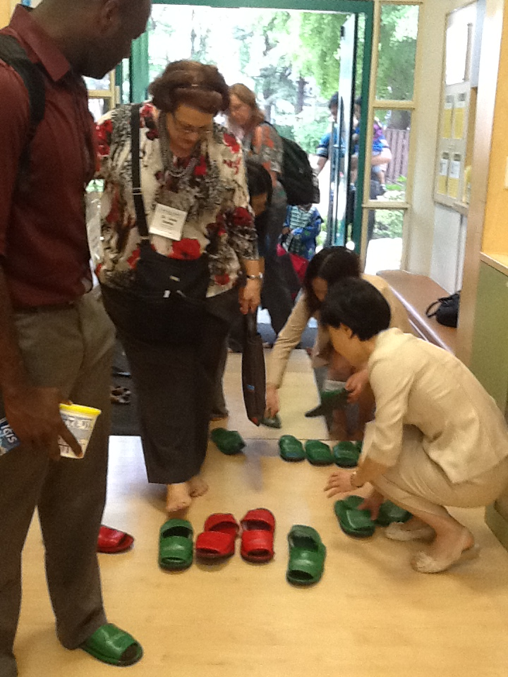
Kindergarten Daily Schedules
Program | Age Group | Time
Half-Day | 3-year olds | 9am-11:50 am
 | 4-year olds | 9am- 12:20pm
 | 5-year olds | 9am-1:50pm
Full-Day | Flexible | 9am-5:20pm

Slide 18
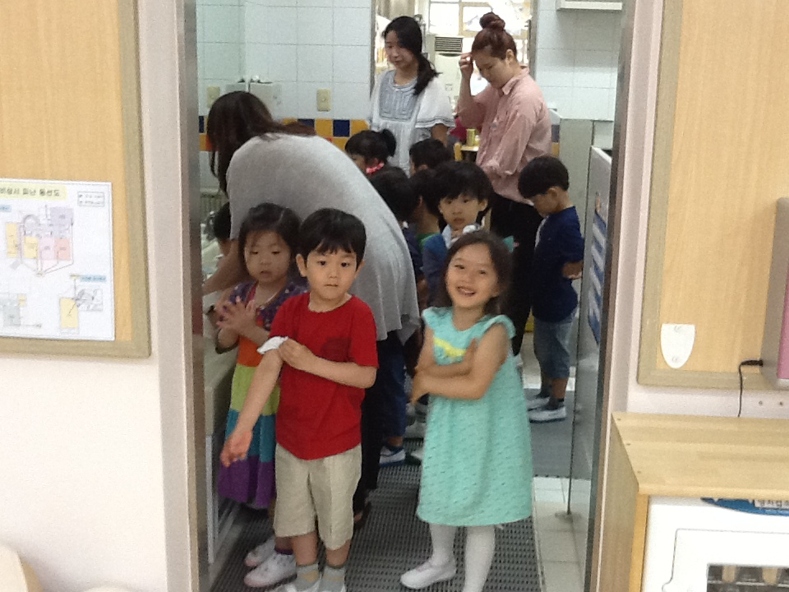
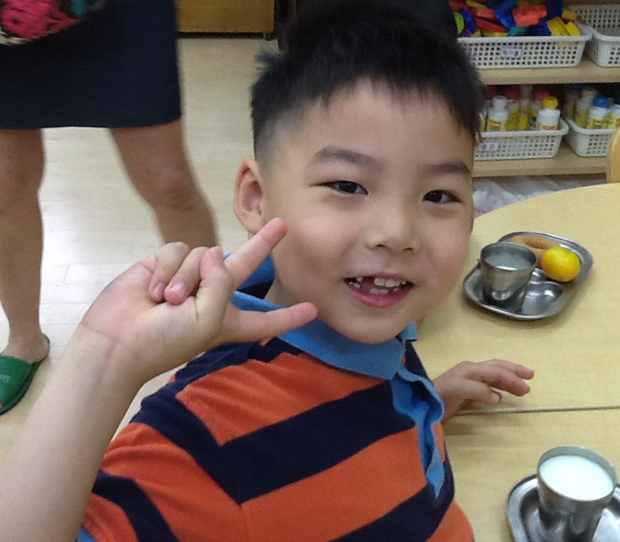
Half-Day Program for 4 Year Olds
Time | Activities
9:00~9:20 | Children make their plans for the day
9:20~10:20 | Center Time
10:20~10:35 | Transition with music to clean-up and toileting
10:35~11:10 | Circle Time: conversations & expressions
11:10~11:30 | Prepare for and eat snack
11:30~12:20 | Playground
12:20~12:30 | Prepare for Dismissal: Discuss events of the day, resolve any conflicts, bow to the teacher
12:30~12:40 | End the Day: Prepare the shoes

Slide 19
Full-Day Program for 5 Year Olds
Times | Activities
8:30am~5:30pm
This schedule is flexibly run Monday – Friday. The full program includes lunch and rest time which allows children to try and taste various nutritious foods and relaxation and stretch out exercises.

Slide 20
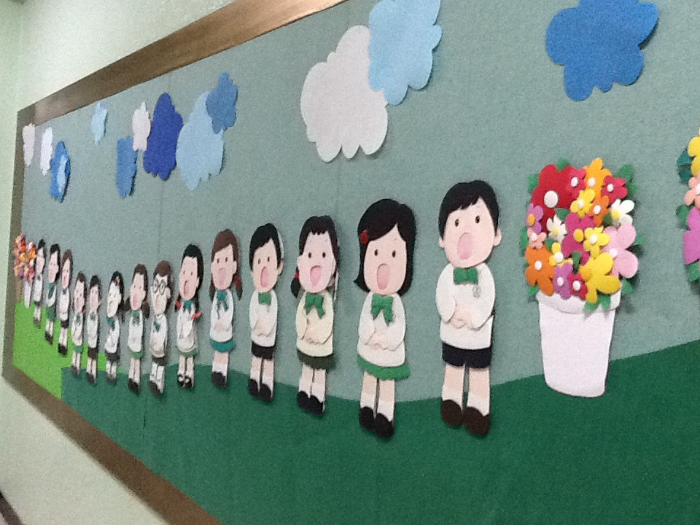
elementary

Slide 21
Elementary School (age 7 - 12):
Core Subjects
Math
Science
English
Social Studies
Fine Arts
PE
Music
Practical Arts
Moral Education

Slide 22
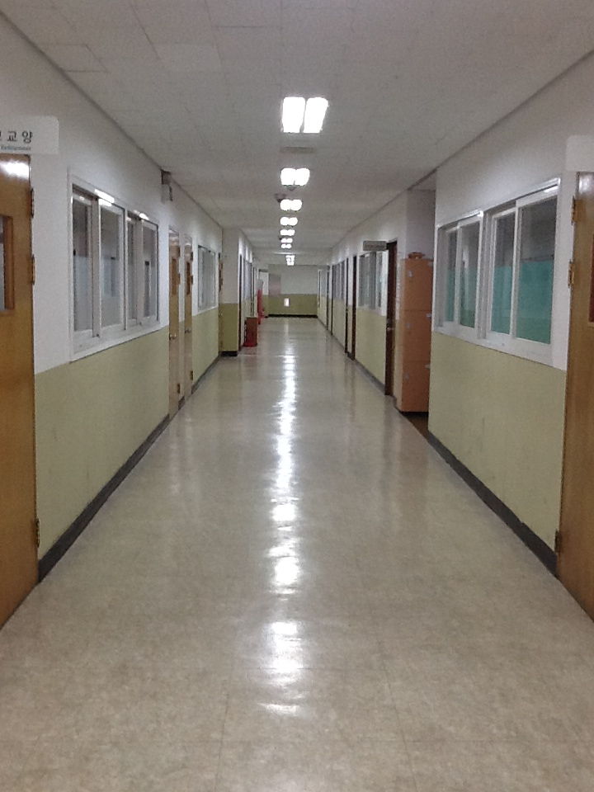
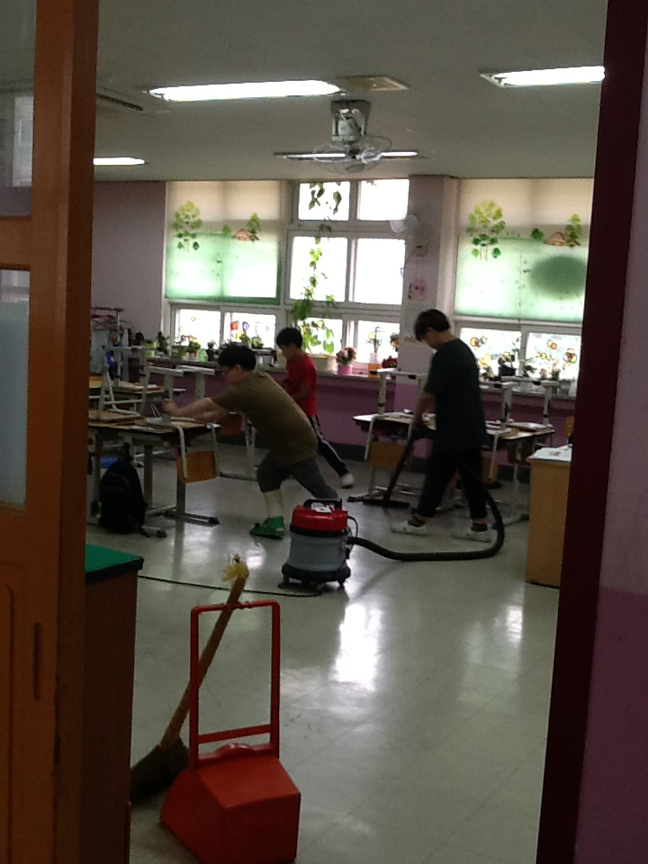
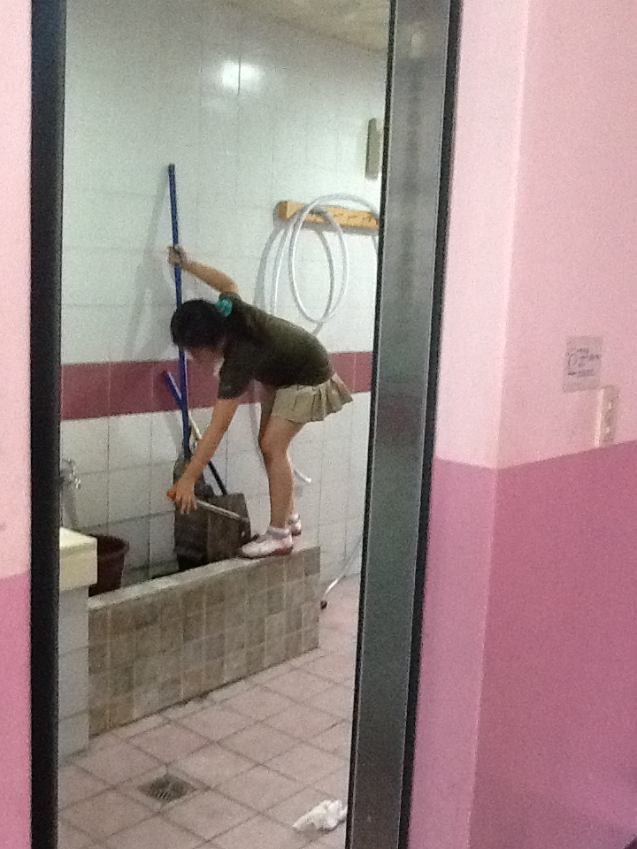
Elementary School (age 7 - 12):
Additional goals
Basic problem-solving skills
Appreciation of tradition and culture
Love for neighbors and country
Basic life habits

Slide 23
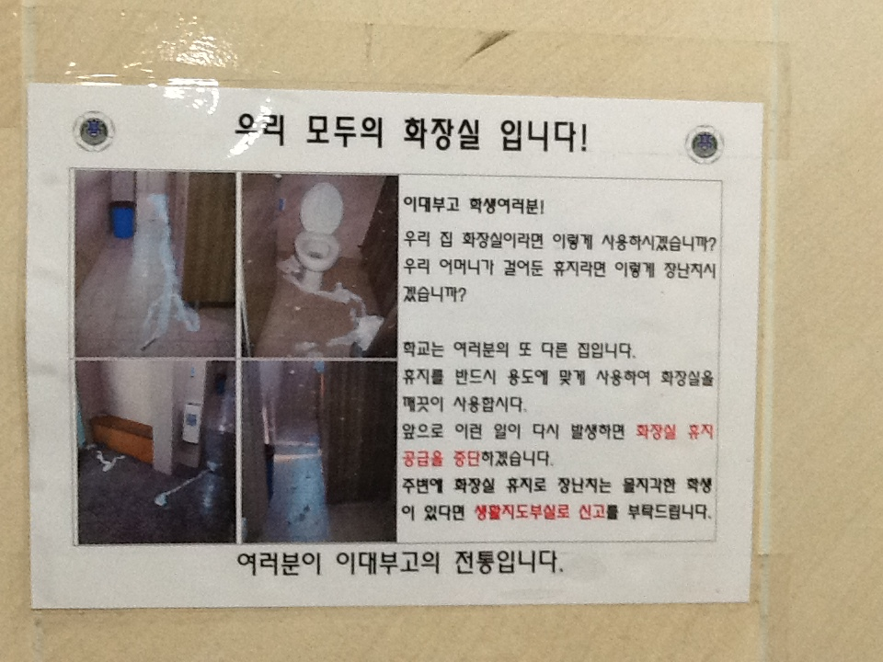
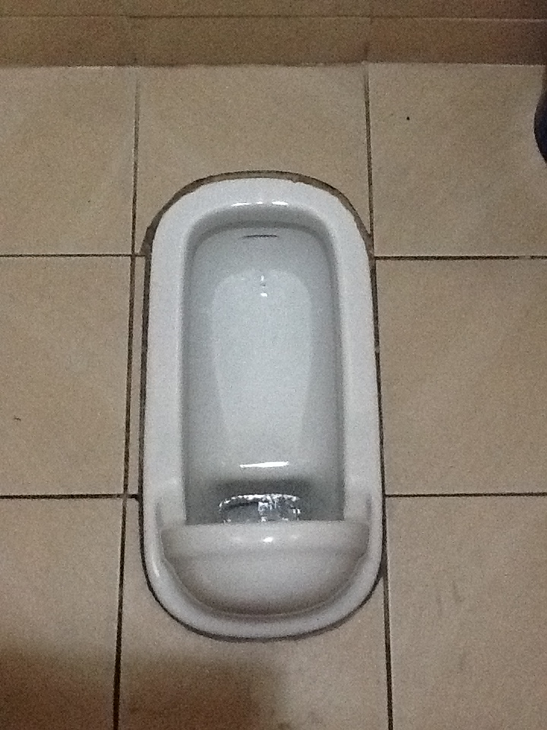

Slide 24
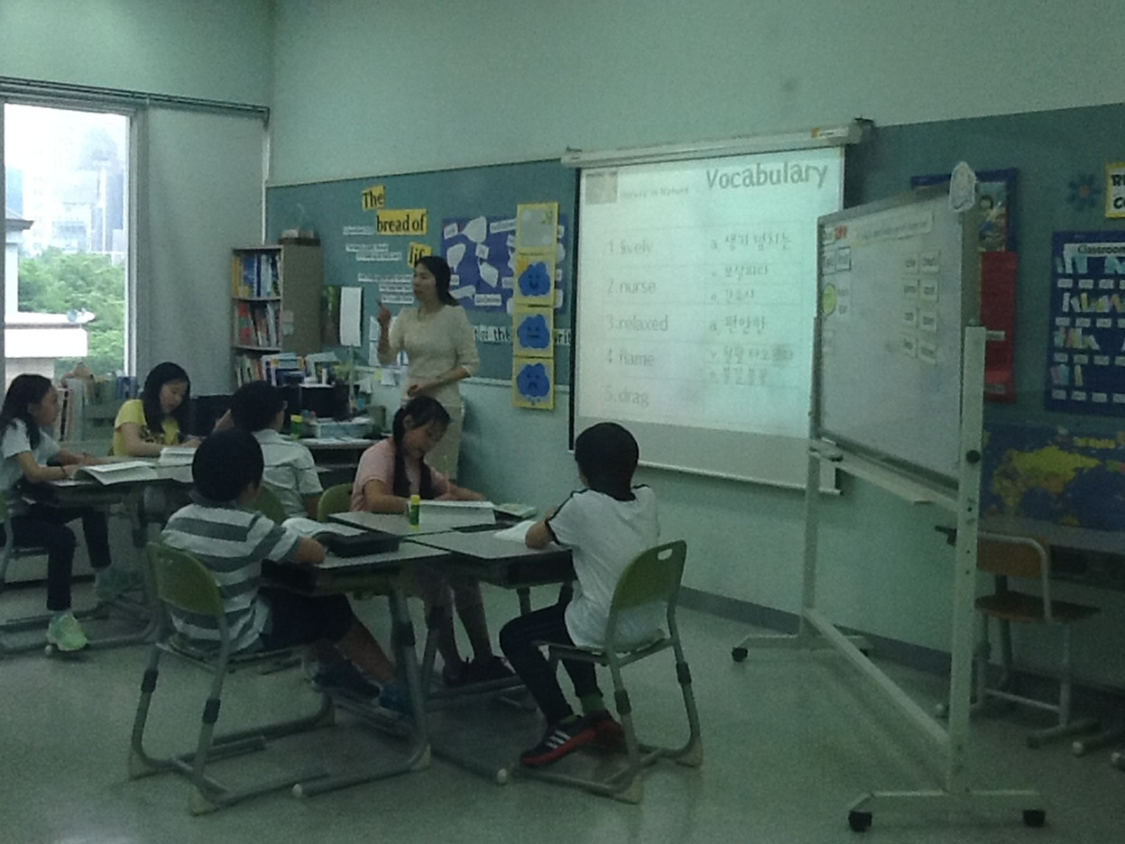
Elementary Daily Schedule
Times | Activities
8:15~9:10 | Science
9:15~9:55 | Language
10:05~10:45 | PE
11:00~11:40 | English
11:50~12:30 | Lunch/Free Time
12:40~1:20 | Math
1:30~2:10 | Social Studies/Manners
2:20 ~3:00 | Self Study
3:10~3:50 | English After School Class
The order of the activities is at the teacher’s discretion.

Slide 25
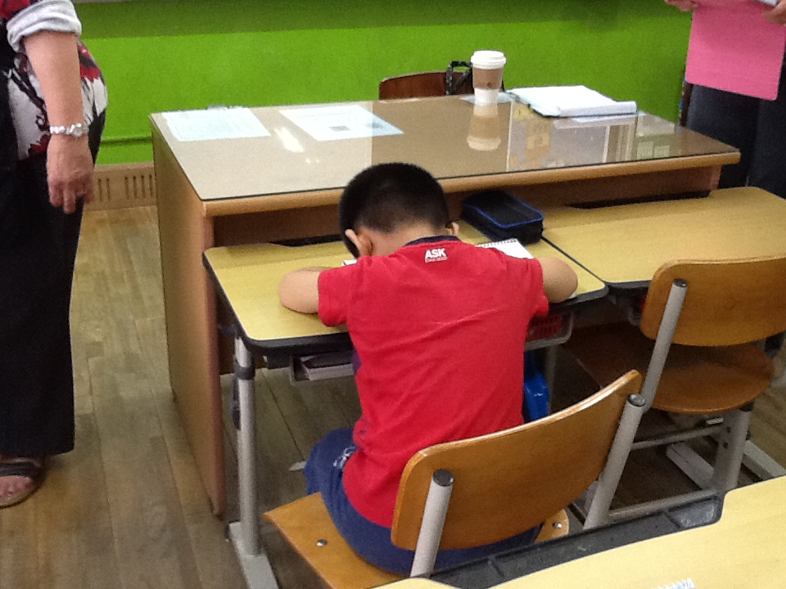
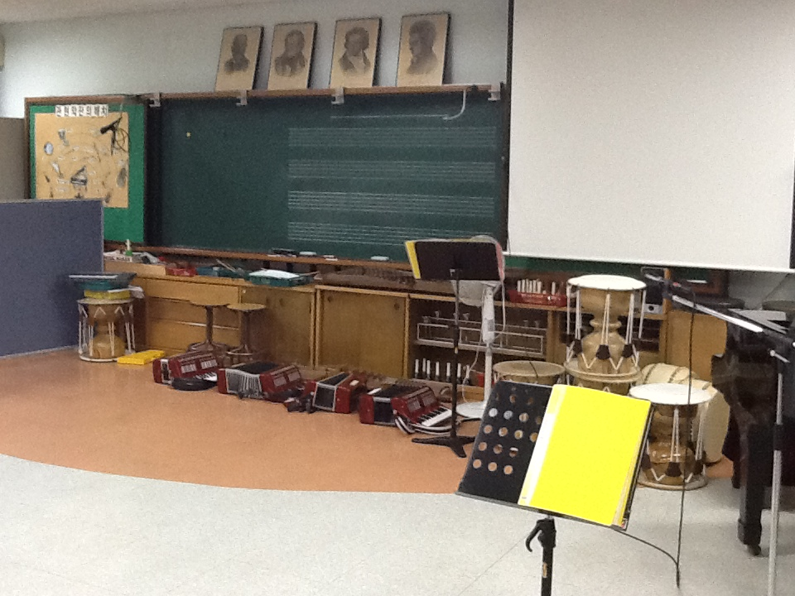

Slide 26
Middle School (age 13 - 16):
Represents a dramatic change from elementary schools. Middle school students are expected, and in many cases subject to considerable pressure, to take education very seriously. School uniforms, haircuts and attitude are usually controlled and homeroom teachers are expected to play a key role in the students’ lives. Similar to elementary schools, students in middle school usually spend the duration of their day with the same classmates with different teachers coming and going for each subject

Slide 27
Middle Daily Schedule
Times | Activities
7:15 | Wake up!!!
7:15~8:03 | Grooming
8:03~8:15 | Arrive School
8:15~8:50 | Morning Job
8:50~9:00 | Rest Time/Prep for 1st period
9:00~9:45 | 1st Period
9:45~9:55 | Rest Time
9:55~10:45 | 2nd Period
10:45~10:55 | Rest Time
10:55~11:35 | 3rd Period
11:35~11:45 | Rest Time

Slide 28
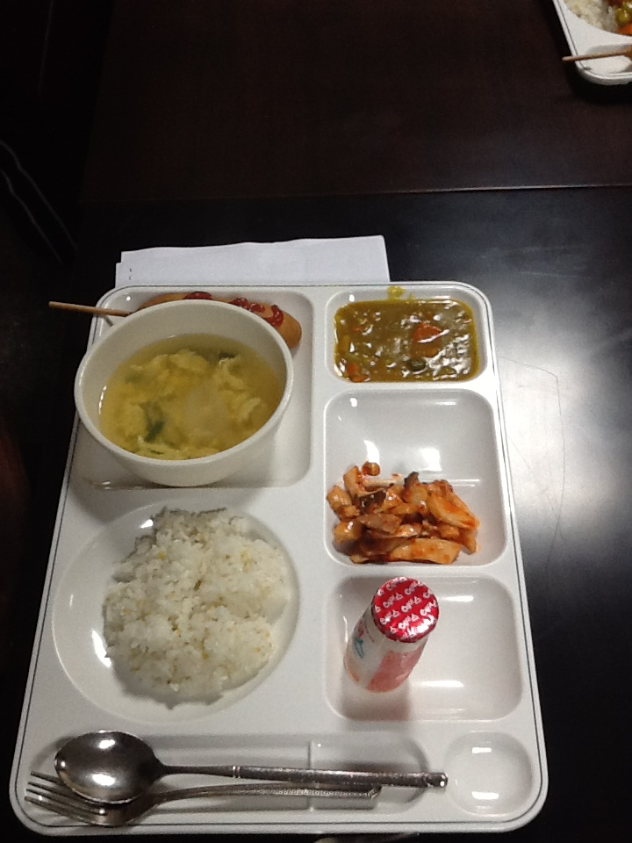
Middle Daily Schedule Con’t
Times | Activities
12:30~1:25 | Lunch
1:25~1:30 | Prep for 5th period
1:30~2:15 | 5th period
2:15~2:25 | Rest Time
2:25~3:10 | 6th Period
3:10~3:20 | Rest Time
3:20~4:05 | 7th period
4:05~4:10 | Dismissal Prep
4:10~4:20 | Clean classroom
4:20~4:30 | End of School
4:30~5:00 | Free time
5:00~6:30 | Tutoring

Slide 29
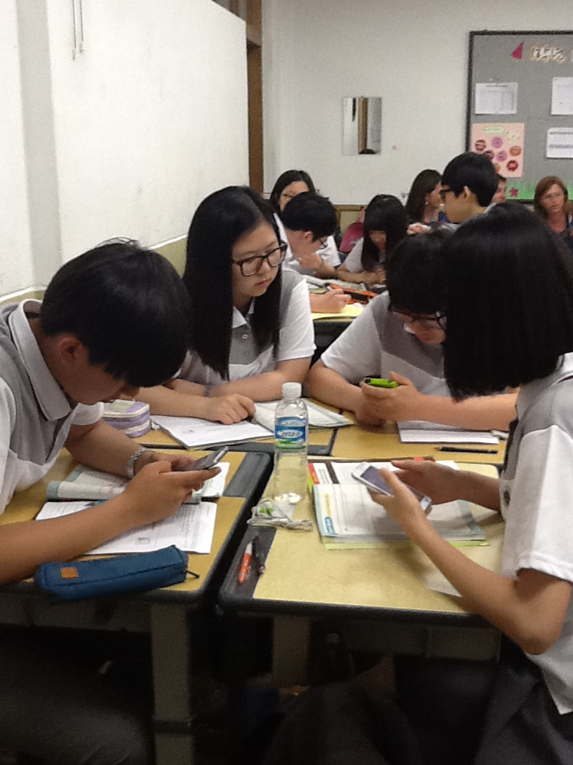
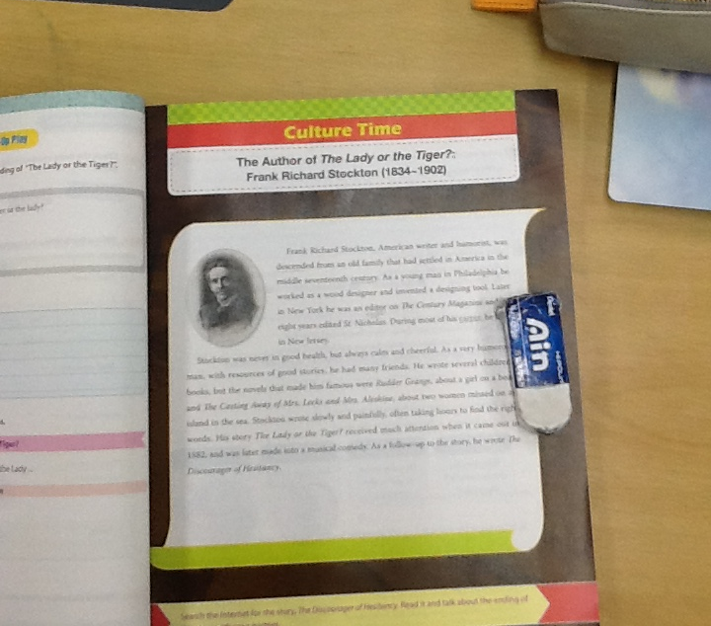
High school

Slide 30
High School (age 17 - 18 or 19):
Public/Private High Schools
Vocational schools
Students who plan to enter the workforce immediately after high school
Finance, technology, agriculture, etc.
Specialty high schools
College-bound students
divided into specific tracks that are geared towards a student’s career path or areas of strong abilities.
Highly competitive and entrance examinations are usually required.

Slide 31
Jessie
“In my high school years, I should go to school by 7:20 AM and 1st class starts at 8:30. However, Korean government forces some schools to starts at 9:00 AM So, students now are allowed to attend school by 9:00 AM. And we have 9 classes until 6:00PM Then we have dinner and self-study from 7 to 10 pm.”

Slide 32
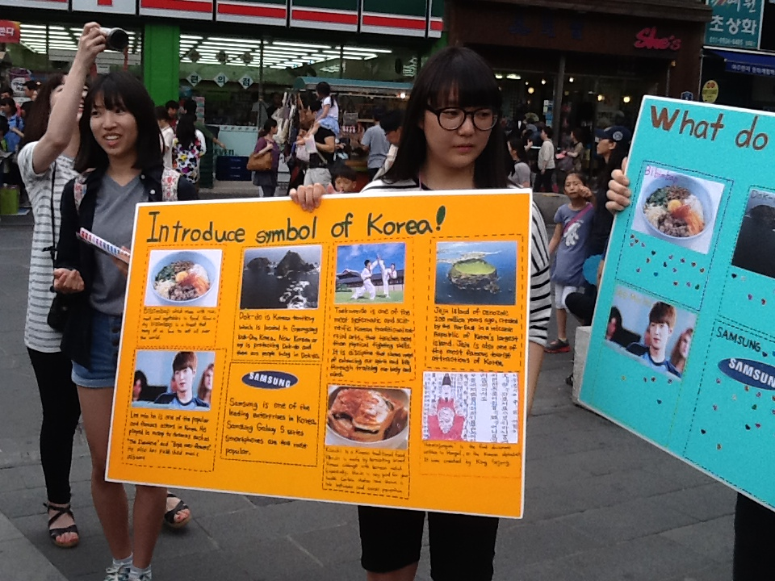

Slide 33
High School Schedule
Times | Activities
7:00~ | Arrive to School
7:10-7:30 | English Listening
7:40-8:20 | 0th class
8:30-9:00 | Morning meeting with class teacher
9:00- 12:00 | 1st, 2nd and 3rd class (each 50 min & 10 break times)
12:00pm - 1:20pm | Lunch time
1:30pm - 5:20 pm | 4th - 8th class
5:30pm -7:00pm | Dinner time
7:00pm -10:00pm | Self-study time 1
10:00pm -12:00am | Self study time 2 (not mandatory)

Slide 34
Student 3
“On weekdays, they have 7~8 classes a day. After dinner, they study in a classroom until 10 or more. On weekends, it is not that different! They go to academy (we call it 'Ha kwon' in Korean.), and study their weak subjects there. Sometimes, they have free times with friends on weekends, but their 'major work to do' is study.”

Slide 35
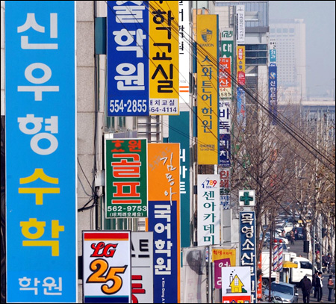
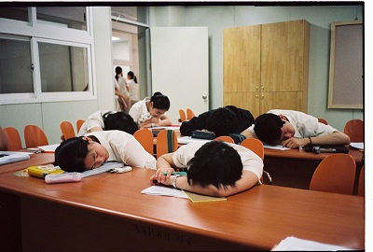

Slide 36
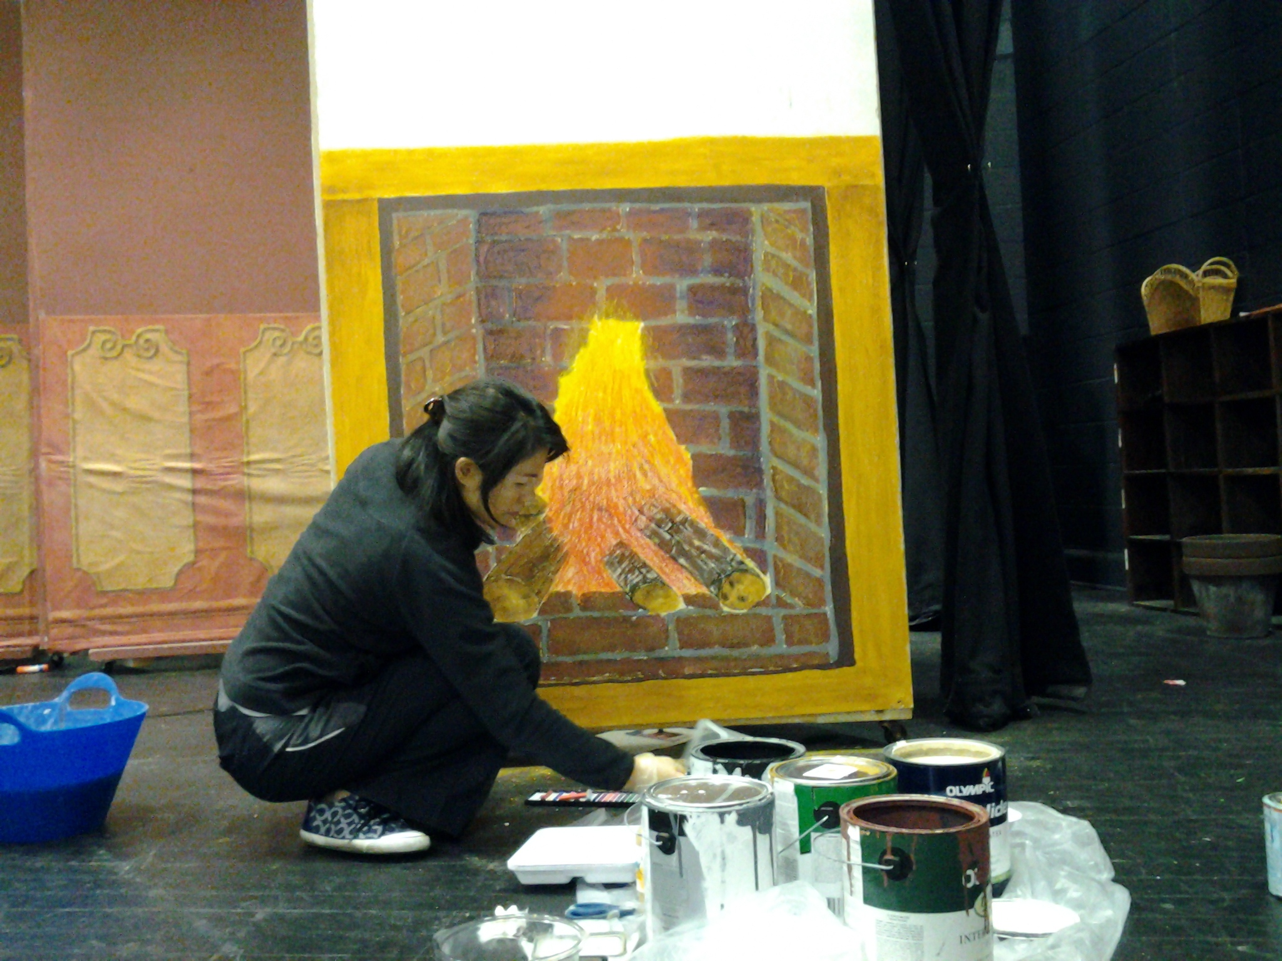
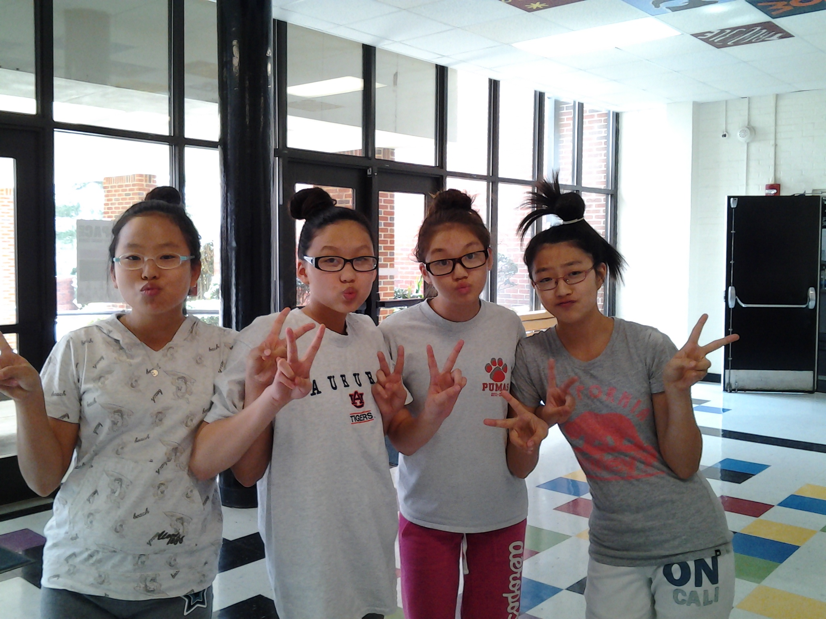
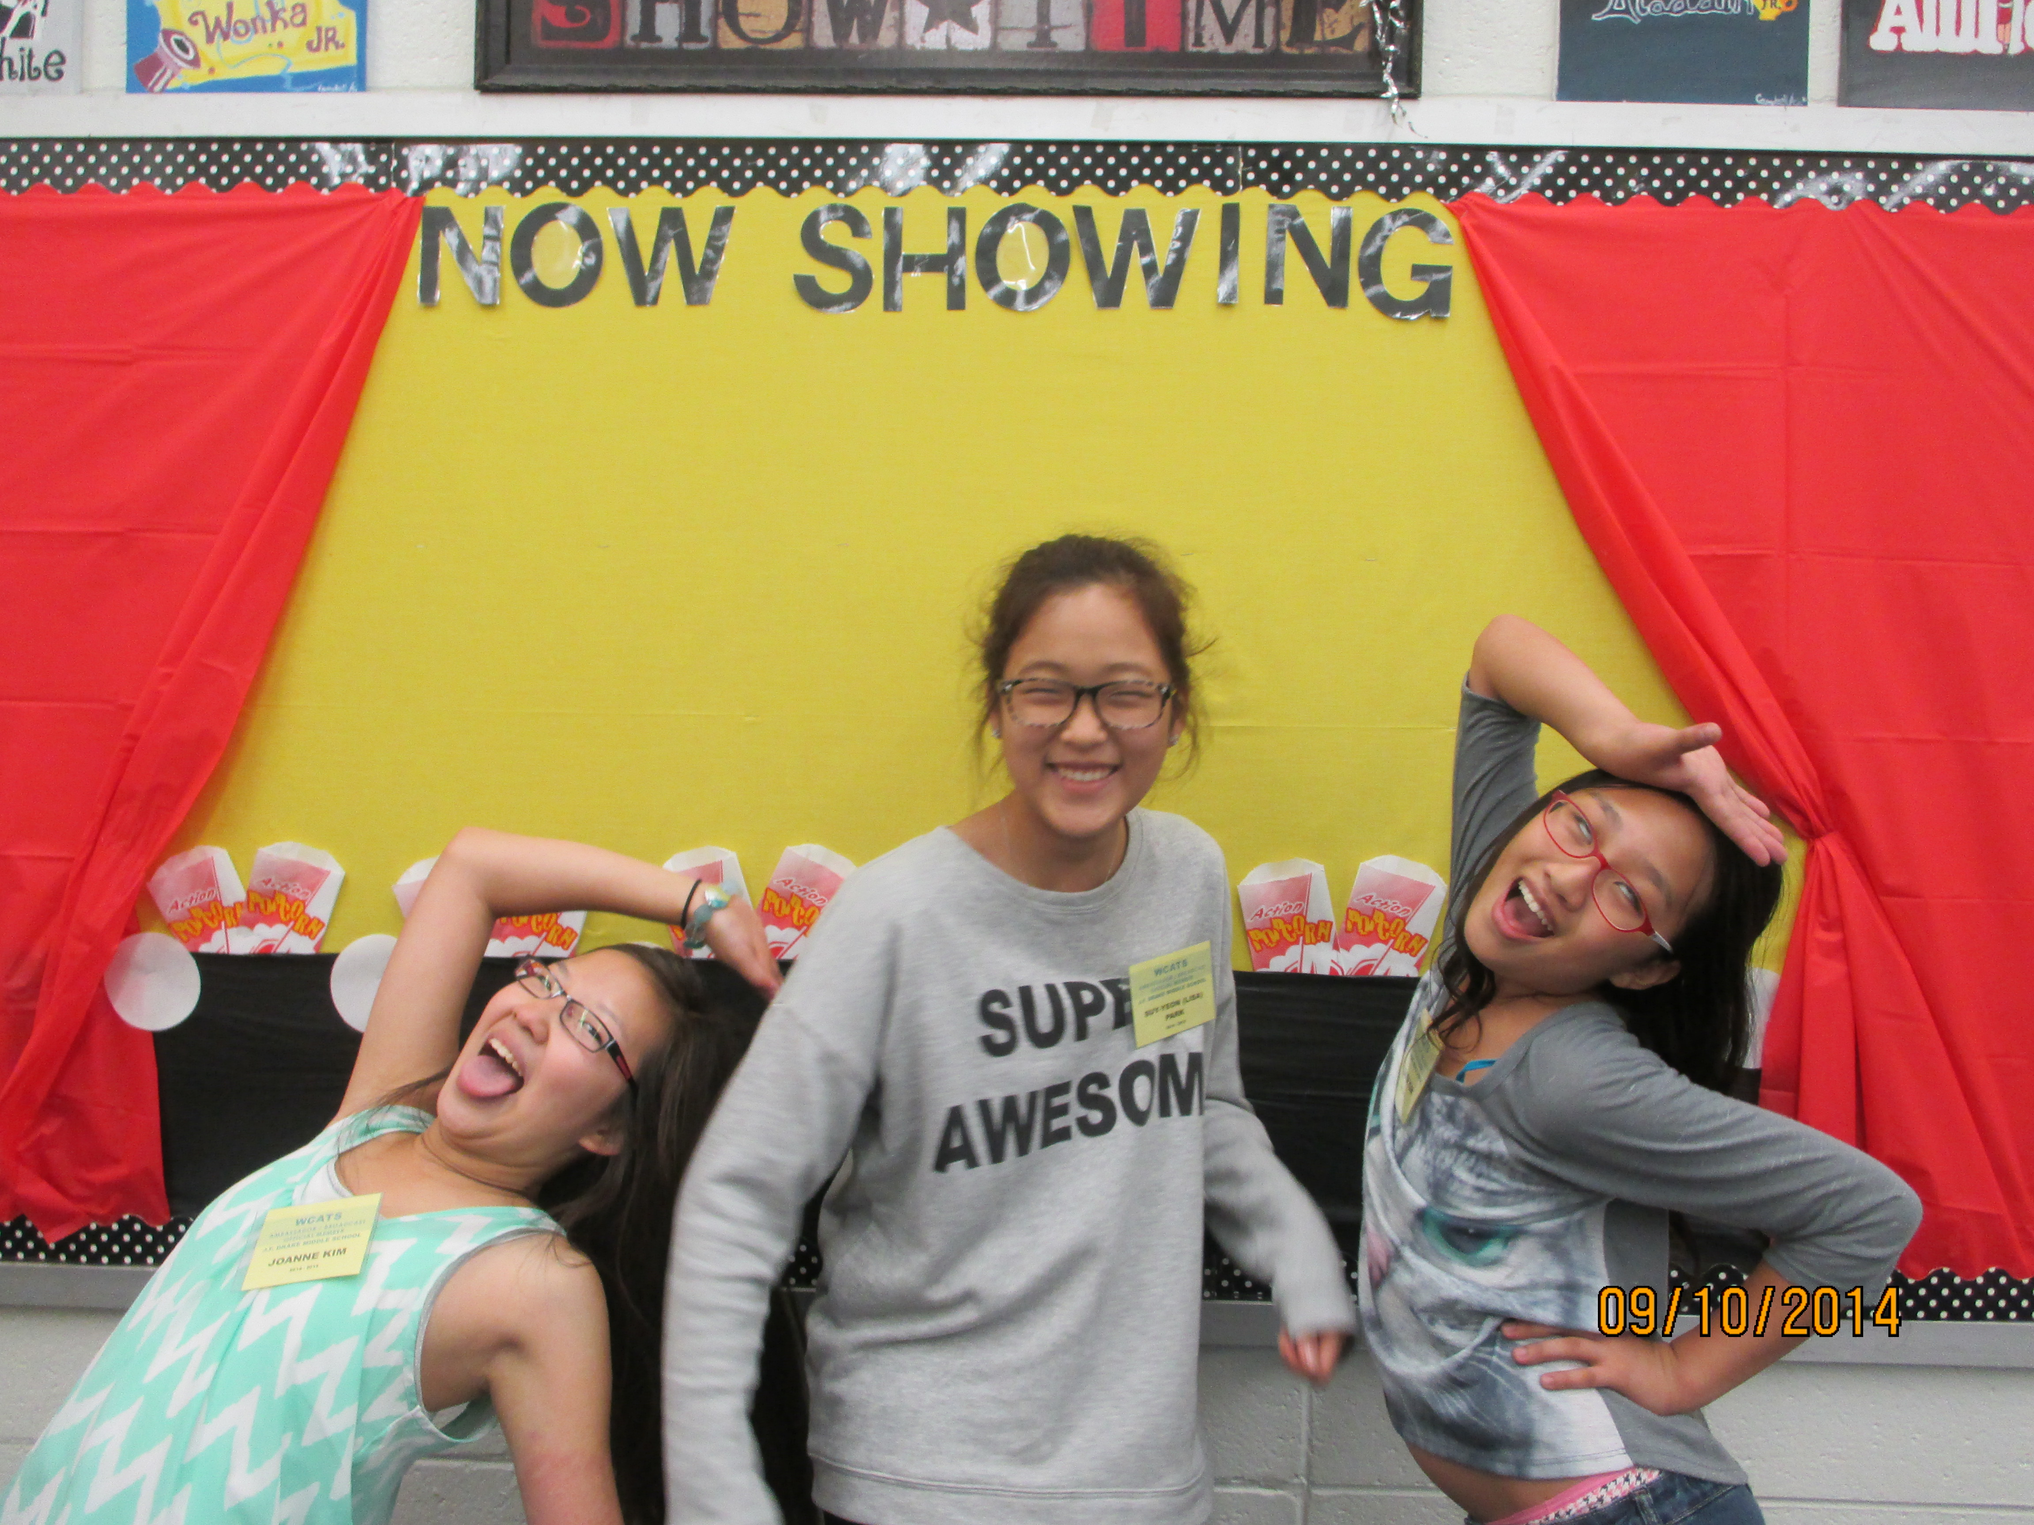
Meet Some of Drake’s Students

Slide 37
Knowledge before understanding
To help me is to know me, and knowing me begins with understanding me!

Slide 38
References & Resources
http://www.koreatimes.co.kr/www/news/opinon/2009/03/165_37117.html
https://www.google.com/search?q=korean+cars&espv=2&biw=1280&bih=923&source=lnms&tbm=isch&sa=X&ei=phAZVMWqBJLoggSa34GQAg&ved=0CAYQ_AUoAQ#tbm=isch&q=hagwons+in+seoul&facrc=_&imgdii=_&imgrc=iT39FxTyItxDBM%253A%3BxZjeD_e0SOWlxM%3Bhttp%253A%252F%252Fres.heraldm.com%252Fcontent%252Fimage%252F2012%252F12%252F10%252F20121210000968_0.jpg%3Bhttp%253A%252F%252Fwww.koreaherald.com%252Fview.php%253Fud%253D20121210000781%3B650%3B457
http://jeollanamdosalad.wordpress.com/2012/06/04/korean-elementary-schools/
https://www.google.com/search?q=daily+schedule+for+korean+elementary+school&sa=X&bih=923&biw=1280&espv=2&tbm=isch&tbo=u&source=univ&ei=rz4ZVO6sE8zwgwT6zIHwAg&ved=0CFAQsAQ#facrc=_&imgdii=_&imgrc=0IcVtGSuZkjG1M%253A%3BFzou9HJa_Vy3yM%3Bhttp%253A%252F%252Fpds.joins.com%252Fjmnet%252Fkoreajoongangdaily%252F_data%252Fphoto%252F2014%252F08%252F05214622.jpg%3Bhttp%253A%252F%252Fkoreajoongangdaily.joins.com%252Fnews%252Farticle%252Farticle.aspx%253Faid%253D2993064%3B600%3B744

Slide 39
References & Resources Con’t
http://www.ncee.org/programs-affiliates/center-on-international-education-benchmarking/top-performing-countries/south-korea-overview/south-korea-instructional-systems/
“Korean Youth Study Longest Hours in OECD,” The Chosunilbo, Aug. 10, 2009.
Ministry of Education, Science and Technology. (2008).Elementary and Secondary Education Act.
Ministry of Education, Science and Technology. (2006). Rules on the General Education Development Test for Qualifications to Enter High School.
Korea Institute of Curriculum and Evaluation. (n.d.) The PISA Results and the Education System in Korea. (PDF
http://www.gone2korea.com/education-in-korea.html
)

Slide 40
Special Thanks to…
J. F. Drake Middle School 7th Grade Korean Students:
Chan Ilji
Jeoung Jim
Junhee Minjae
Soyoung Suyeon

Slide 41
