Slide 1
Korean songs

Slide 2
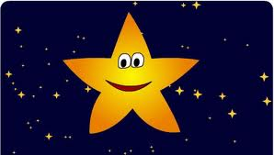
Twinkle Twinkle Little Star
Twinkle Twinkle little star
How I wonder what you are
Up above the world so high
Like a diamond in the sky.
Twinkle Twinkle little Star
How I wonder what you are

Slide 3
Twinkle Twinkle Little Star
Bahn-Jjak Bahn-Jjak Jahk-eun Byul
Ah-reum-dahb-geh Bee-chee-neh
Seo-Jjok Ha-neul-eh-suh-doh
Dong-jjok Ha-neul-eh-suh-doh
Bahn-Jjak Bahn-Jjak Jahk-eun Byul
Ah-reum-dahb-geh Bee-chee-neh

Slide 4
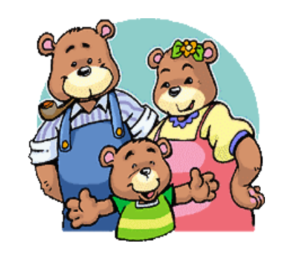
Three Bears
Look! There are three bears
All in the same house
Father Bear, Mother Bear, Little bear
Father Bear is very fat
Mother Bear is very slim
Little Bear is so cute I could die
What a happy family!

Slide 5
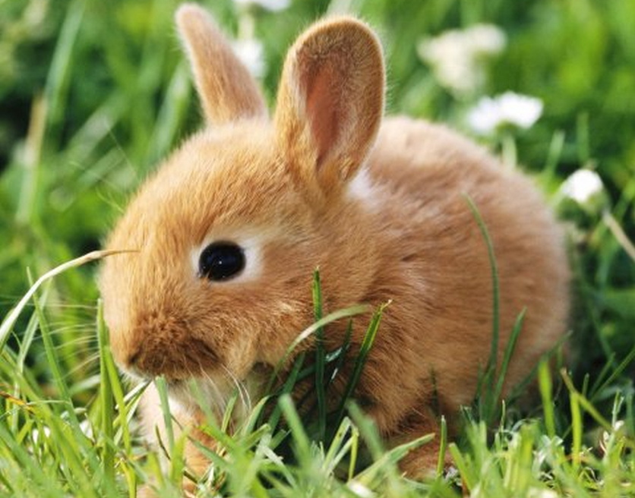
Jack Rabbit
Jack Rabbit Jack Rabbit
Where are you going now?
Jumping Jumping everywhere!
Where are you going now?

Slide 6
Jack Rabbit
Sahn-Tokki Tokkiyah
Uh-dee-reul Ga-neu-nyah?
Kkang-chong Kkang-chong Ddui-myun-suh
Uh-dee-reul Ga-neu-nyah?

Slide 7
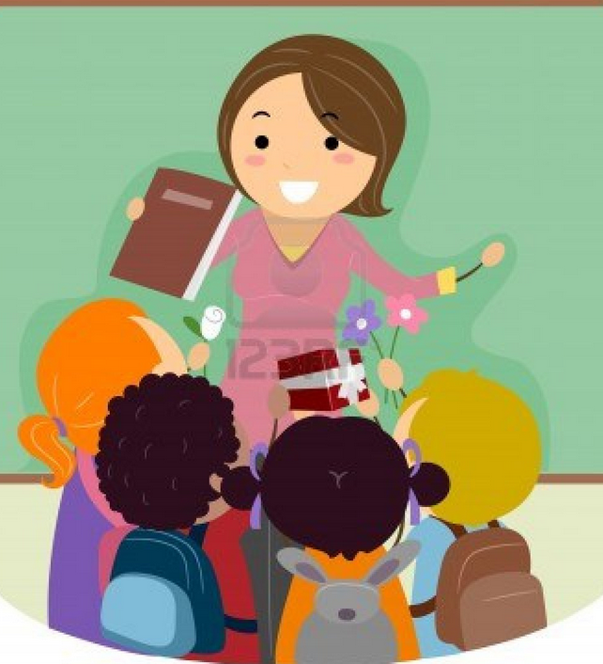
Teachers’ Grace
From teachers come a grace that is like the sky As we look up the higher it goes You’ve taught us to be honest and to do right Guiding us with a parental heart (refrain) Ah, Ah, thank you for your love Ah, Ah, we hope to reciprocate this grace

Slide 8
Our Wish is for Unification
Our wish is for unification (of North and South Korea) Even in dreams we wish for unification Let’s give our utmost efforts for unification That unification may be attained A unification to revive this people A unification to revive this nation Oh unification come quickly Oh unification come…

