Slide 2
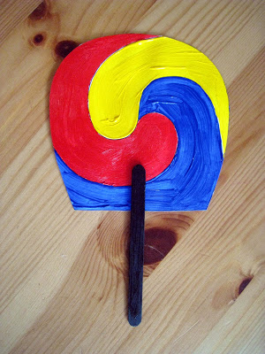
Traditional Korean Sam Taeguk Fan
The Sam Taeguk symbol is found on tradional Korean fans. It is a variation of the Taeguk symbol found on the Korean National flag. The Taeguk is comprised of two colors, red and blue. The red represents heaven and the blue represents earth. The symbol represents harmony similar to a Ying Yang symbol. The Sam Taeguk includes yellow to represent man.
http://4crazykings.blogspot.com/2009/08/traditional-korean-sam-taeguk-fan.html

